Slide 1

Latency reversal in vivo
Thomas A Rasmussen
Doherty Institute for Infection and Immunity
University of Melbourne
IAS Conference on HIV Science, Mexico City 2019

Slide 2
No conflicts of interest to declare

Slide 3
HIV persistence in long-lived and proliferating cells
T cell
survival
T cell
proliferation
Finzi Science 1997; Chun PNAS 1997; Chomont Nat Med 2009; Buzon Nat Med 2010; Hatano JID 2013; Fletcher PNAS 2014; Maldarelli Science 2014; Crooks JID 2015; Simonetti PNAS 2016; Lorenzo-Redondo Nature 2016; Hosmane JEM 2017; Wang PNAS 2018; Rasmussen Lancet HIV 2018

Slide 4
Reversing HIV latency: Shock but no kill
Activate latent HIV using latency-reversing agents such as HDAC inhibitors, PKC activators, disulfiram
Shock
Kill
ART
ART
ART
ART
ART
Archin Nature 2012; Vandergeeten Blood 2013; Archin JID 2014; Elliott Plos Path 2014, Rasmussen Lancet HIV 2014; Sogaard Plos Path 2015; Elliott Lancet HIV 2015; Leth Lancet HIV 2016; Gutierrez AIDS 2016

Slide 5
Key questions in shock and kill
Are there more potent agents or approaches with better specificity?
Could immunomodulatory or pro-apoptotic agents that also reverse latency play a role in cure research?
And if so - how do we reduce the risk of toxicities associated with these compounds?
Given the studies done so far what is the role of shock and kill going forward?

Slide 6
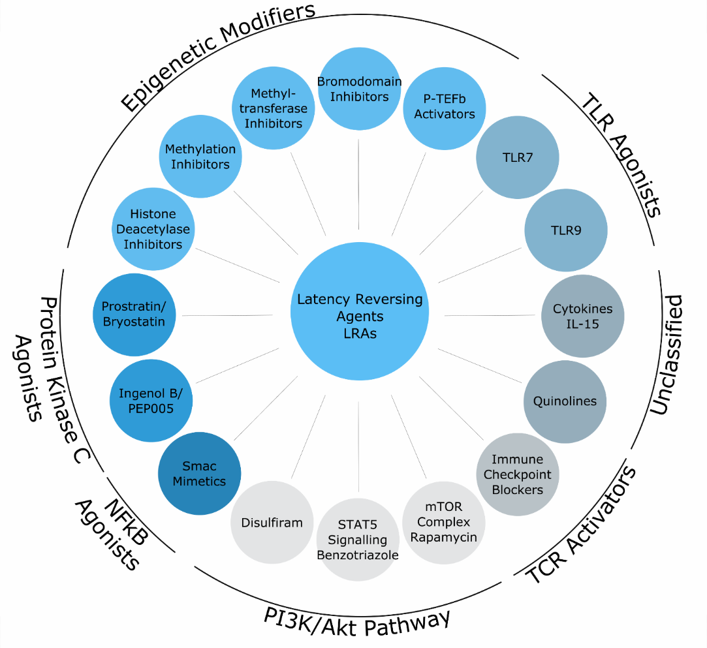
Multiple latency-reversing agents have shown activity
Clinical trial complete
Clinical trial ongoing
SMAC mimetic AZD5582 reversed SIV-latency with increases in plasma VL in 42-55% of macaques
(Mavigner, Dunham, Margolis, Chahroudi et al CROI 2019)
Outline
Romidepsin
Discovering HIV-specific LRAs
TLR7 and TLR9 agonists
Immune checkpoint inhibitors
Kim, Anderson and Lewin. Cell Host Microbe 2018

Slide 7
Do romidepsin really reverse latency?
4 doses of romidepsin did not increase plasma or cell-associated HIV despite increases in histone acetylation and activated NFkB and P-TEFB (McMahon, Mellors et al, CROI 2019)
In contrast, two previous studies demonstrated latency reversal
Romidepsin single-agent study
HIV vaccine + romidepsin study
FC cell-associated HIV RNA
Cell-associated HIV RNA
Sogaard Plos Path 2015
Leth Lancet HIV 2016

Slide 8
Latency reversal with romidepsin
 | Romidepsin, ACTG (McMahon, CROI 2019) | Romidepsin (Sogaard, Plos Path 2015) | Vacc-4x + romidepsin (Leth, Lancet HIV 2016)
Design | RCT (n=15) | Single-arm (n=6) | Single-arm (n=17)
Dosing | 4 doses at 5 mg/m2 | 3 doses at 5 mg/m2 | 3 doses at 5 mg/m2
HIV transcription | No change | 3-4 fold-increase seen 30 min post-infusion | 3-fold increase seen 30 min post-infusion
Plasma VL (>20/mL) | No change | 5/6 (2nd and 3rd) | 7/16
Time points assayed | 24h, 72h and 7 days | 30min, 72h and 7 days | 30min, 72h and 7 days
Dose frequency | Every 14 days | Every 7 days | Every 7 days
Potential explanations for conflicting findings:
Sustained histone acetylation with more frequent dosing may enhance effects of subsequent doses
Effect on HIV transcription may be short-lived and primarily seen immediately post-infusion
Inducible viremia inconsistent across all studies

Slide 9
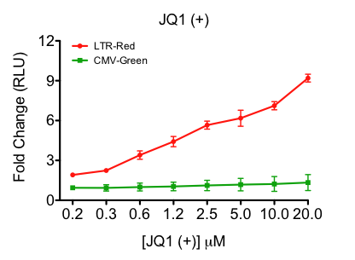


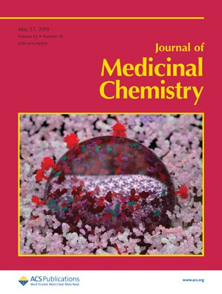
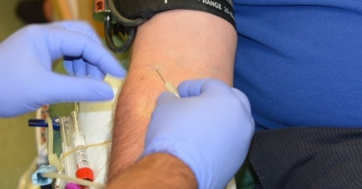
Discovering new LRAs with more specificity
Screening library (n=114,000)
Lead compounds and optimisation
Acylaminothiazols
Ex vivo stimulation of PBMCs from leukapharesis
LTR= HIV long terminal repeat;
CMV = cytomegalovirus
Damian Purcell, Georges Khoury, Jonathan Jacobson, Brad Sleebs, James McMahon and others
Nguyen, J Med Chem 2019

Slide 10
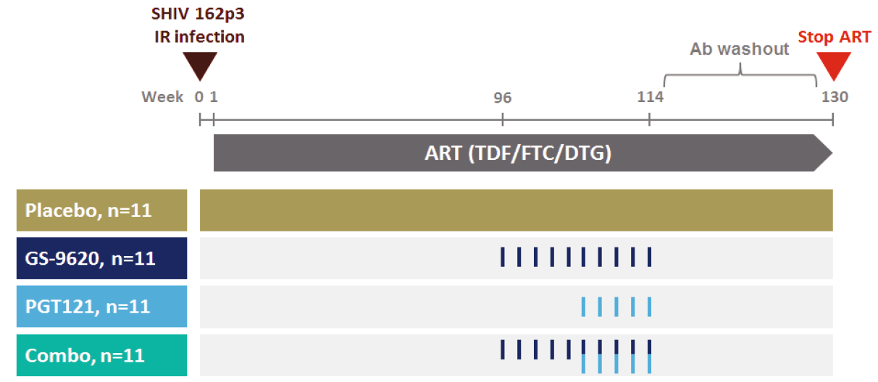
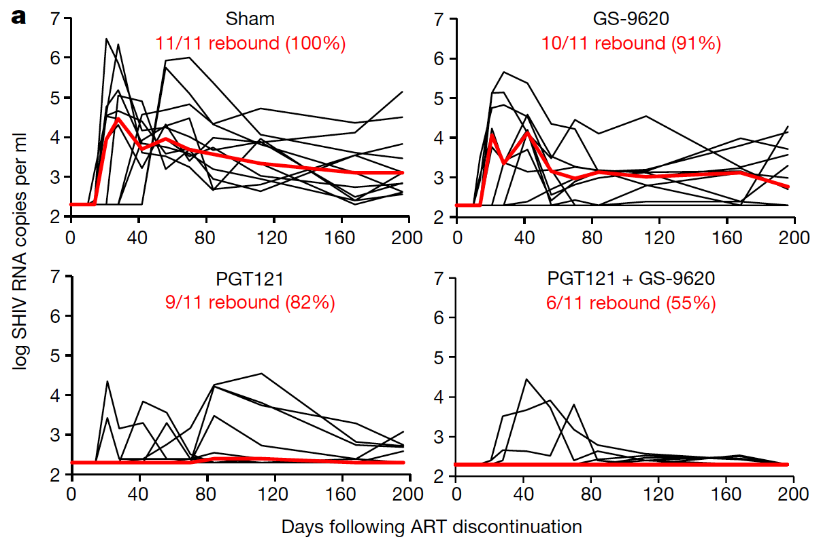
TLR7 agonist + bNAb PGT121 prevented viral rebound
Borducchi, Barouch et al, Nature 2018

Slide 11
TLR7 agonist + PGT121: Shock and kill?
Lewin, Nature 2018
Human study of GS-9620, #WEAA0304

Slide 12
TLR9 agonist lefitolimod (MGN1703)
Part A
Part B
VL>20/mL in 6/15
Vibholm, Sogaard et al, CID 2017
Vibholm, Sogaard et al, AIDS 2019

Slide 13
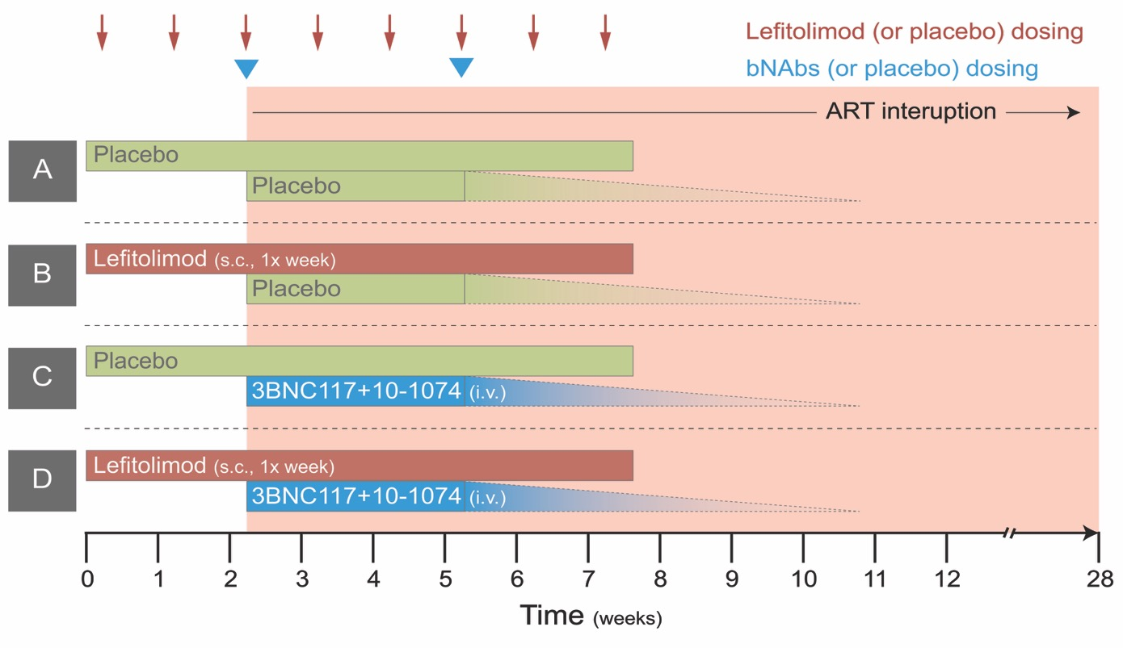
TLR9 agonist + combination bNAb RCT
PI: Ole Søgaard
Currently enrolling HIV+ individuals on ART in
Aarhus (open)
Melbourne (soon)
Utah (soon)
Primary endpoint: Time to VL rebound >10,000/mL

Slide 14
Immune checkpoints modify T cell function
Multiple interactions between APCs and T cells
Inhibitory or stimulatory
Modify the quality and duration of effector response
Wykes and Lewin, Nature Reviews Immunology 2018

Slide 15
Potential dual role of immune checkpoints in HIV
Inhibitory signalling through immune checkpoints leads to exhaustion of HIV-specific T-cells
CD4+ T cells expressing immune checkpoints enriched for HIV
Potential roles of immune checkpoint inhibitors in HIV
Augment HIV-specific T cell function
Enhance vaccine immunogenicity
Activate HIV from latency
Trautmann Nat Med 2006, Kaufman Nat Immun 2009, Chomont Nat Med 2009, Banga Nat Med 2015, Fromentin Plos Path 2016, Chew Plos Path 2016, Fromentin Nat Comm 2019, Uldrick CROI 2019

Slide 16
PD-1 blockade enhances latency reversal ex vivo
CD8- and CD56-depleted PBMCs from ART-suppressed individuals
Stimulated ex vivo with bryostatin (18h) in the absence or presence of anti-PD1
36 (IQR 7.90–47.25) fold-increase over isotype control
Fromentin, Chomont et al, Nature Communication 2019

Slide 17
Cell-associated HIV RNA and RNA/DNA during anti-PD-1
Cell-associated HIV RNA
Cell-associated HIV RNA / DNA
P=0.004
P=0.008
Tom Uldrick et al, Jama Oncol 2019 and
CROI 2019 by Tom Uldrick, Fred Hutchinson Cancer Research Center

Slide 18
Reducing risk of anti-PD1 toxicity:
High receptor occupancy after single low-dose nivolumab (0.3 mg/kg)
Gane et al, J Hepatology 2019
Similar data with 0.1 mg/kg (n=2)

Slide 19
Conclusions
Shock but no kill: Clinical trials of LRAs demonstrated that HIV latency can be disrupted in patients on ART but virus-expressing cells are not eliminated
LRAs that specifically target HIV-infected cells may hold considerable potential for more potent latency-reversal pending further development
Immunomodulatory therapeutics designed to enhance immunity may also reverse HIV latency, including TLR agonists, immune checkpoint inhibitors and IL-15
Potential for combing these compounds with other interventions such as bNAbs, vaccines or pro-apoptotic drugs
Future role of shock and kill: If we maintain complete eradication as the ultimate aim, we need ways to expose latently infected cells to elimination and reversal of latency remains a potential approach to doing this

Slide 20






Acknowledgements
The Doherty Institute of Infection and Immunity, University of Melbourne
  Sharon Lewin
  Vanessa Evans
  Judy Chang
  Jennifer Audsley
  Ajantha Rhodes
  Ashanti Dantanarayana
  Surekha Tennakoon
  Barbara Scher
  Amanda Brass
  Jenny Anderson
  Jori Symons
  Celine Gubser
  Jasminka Sterjovski
  Socheata Chea
  Damian Purcell
  Georges Khoury
  Jonathan Jacobson
Dep. of Infectious Diseases, Alfred Health and Monash University
  James McMahon
  Jill Lau
  Michelle Hagenauer
  Janine Roney
Westmead Millennium, Sydney
Sarah Palmer
Kirston Barton
UCSF, San Francisco
Steven Deeks
Peter Hunt
Rachel Rutishauser
Dep. of Infectious Diseases, Aarhus University Hospital
  Ole Søgaard
  Martin Tolstrup
  Lars Østergaard
  Rikke Olesen
  Anni Winckelmann
Ann-Sofie Kjær
Steffen Leth
Paul Denton
Lene Svinth Jøhnke
Ragon Institute, Boston
Mathias Lichterfeld
University of Colorado
Charles A. Dinarello
Oregon Health Sciences University
Afam Okoye
Louis Picker
University of Montreal
Nicolas Chomont
Remi Fromentin
NIAID
Barbara Felber
Fred Hutchison Cancer Centre
Tom Uldrick
Johns Hopkins University
Christine Durand

